Slide 1




DEVELOPING AN AUTOMATION TO AGENCY SIGNUP
RIYA JOHNSON

Slide 2


PROBLEM STATEMENT
Objective: Automate the identification of agency websites for streamlined onboarding.
Challenges:
Manual analysis of websites is time-consuming.
Subjectivity in decision-making.
Need for structured data storage.

Slide 3



PROPOSED SOLUTION
Steps:
Scrape website content.
Analyze for predefined keywords.
Use AI for deeper content analysis.
Store decisions in a structured format (CSV/Google Sheets).
Tools Used:
Python
BeautifulSoup
Google's Gemini AI model
Pandas

Slide 4

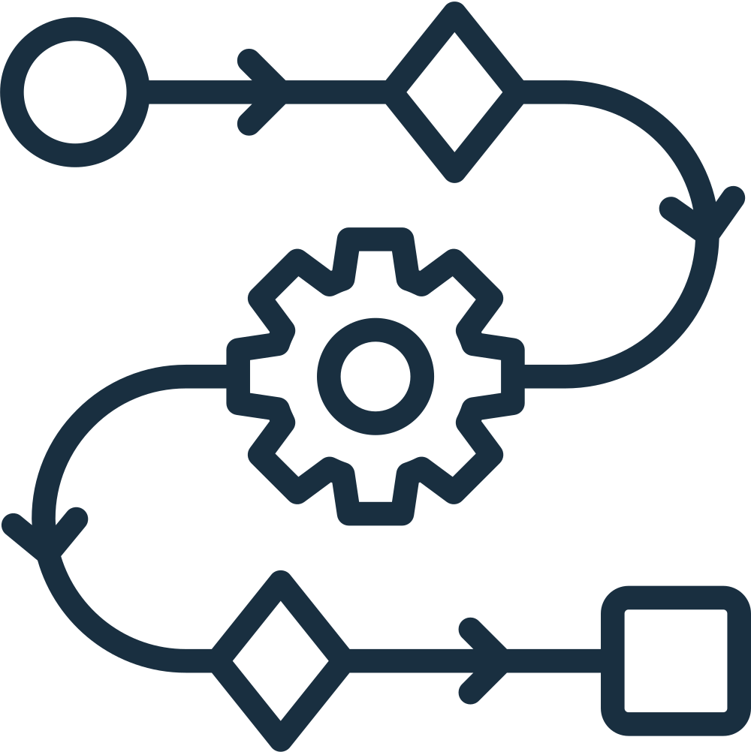
WORKFLOW
Steps Visualized:
Input URLs
Content Scraping
Keyword Analysis
AI-Powered Analysis
Decision-Making Logic
Results Storage (CSV/Google Sheets)

Slide 5
IMPLEMENTATION DETAILS
Content Scraping:
The system initiates a request to the target website, similar to a web browser fetching a page.
The received HTML content is then parsed using BeautifulSoup, a powerful library designed to navigate and extract information from HTML structures.
Visible text content, crucial for understanding the website's purpose, is carefully extracted and stored for subsequent analysis.
Keyword Matching:
The extracted website content is scanned for the predefined keywords.
Matches are recorded, providing an initial indication of the website's relevance to the agency category.

Slide 6
IMPLEMENTATION DETAILS
AI Analysis:
The extracted website content, often truncated to fit AI input limits, is fed to the Gemini model.
A carefully crafted prompt guides the AI to analyze the content and determine if it aligns with the characteristics of an agency website.
Gemini's response, encompassing its classification decision (yes/no) and supporting rationale, provides valuable insights that complement keyword analysis.
Decision Logic:
A rule-based system integrates the findings from keyword matching and AI analysis.
Based on predefined criteria, each website is assigned to one of the decision categories.

Slide 7
THANK YOU

